Slide 1
Tutorial for Jump Rope access
JumpRope is our new online grade book for Level 4. Follow the tutorial to see all of the features and information available to your family.
Go to www.jumpro.pe
Click on the Log In button – Now follow the rest of the steps in the tutorial.

Slide 2
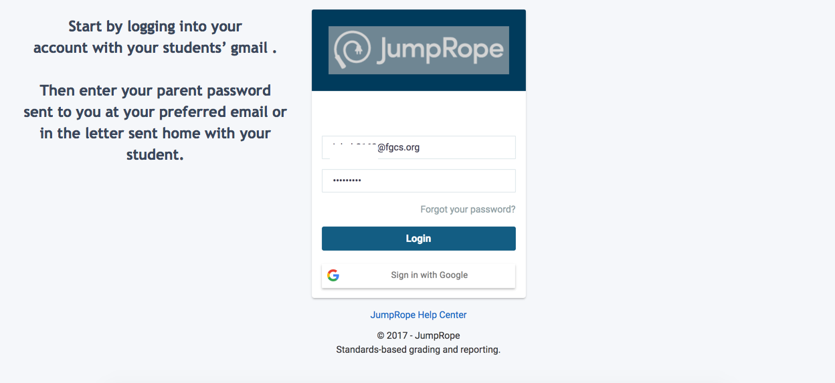

Slide 3
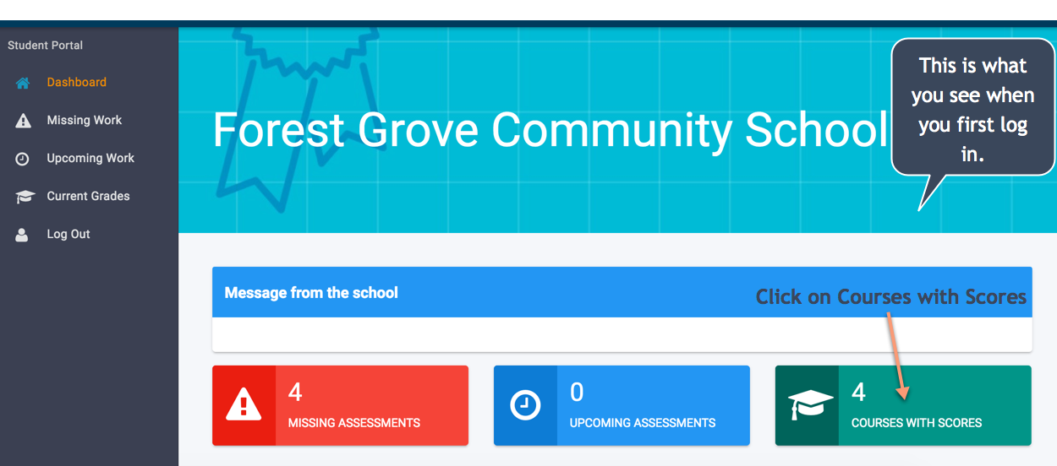

Slide 4
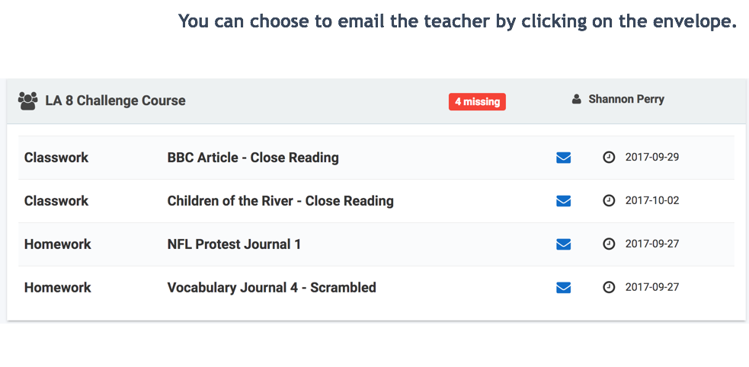

Slide 5
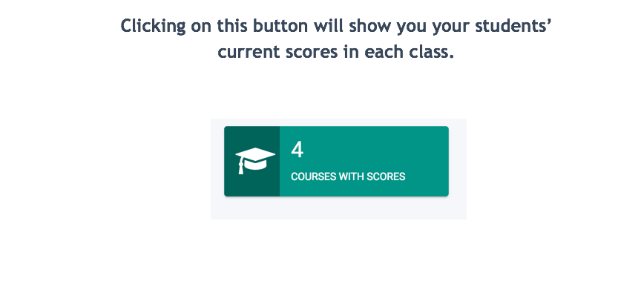

Slide 6
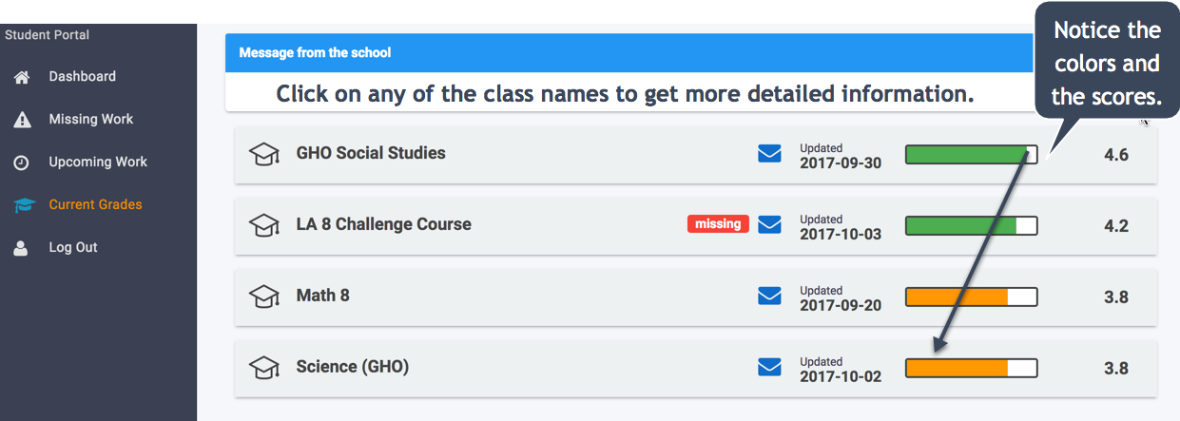

Slide 7
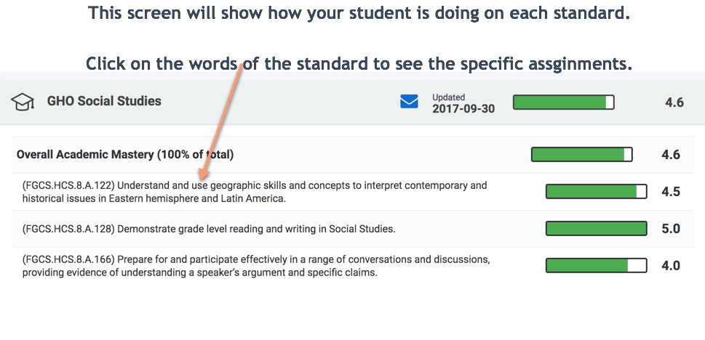

Slide 8
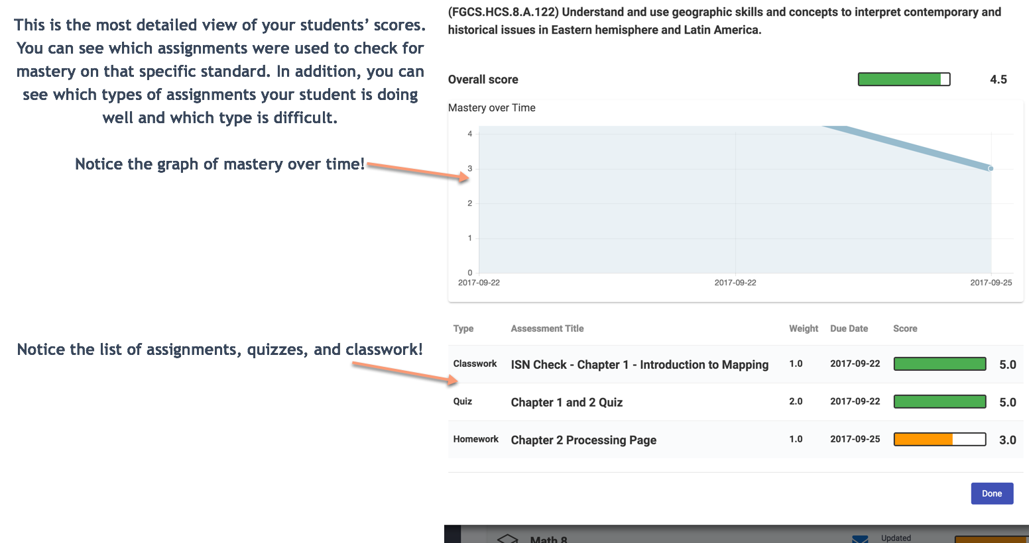

Slide 9
